Slide 1
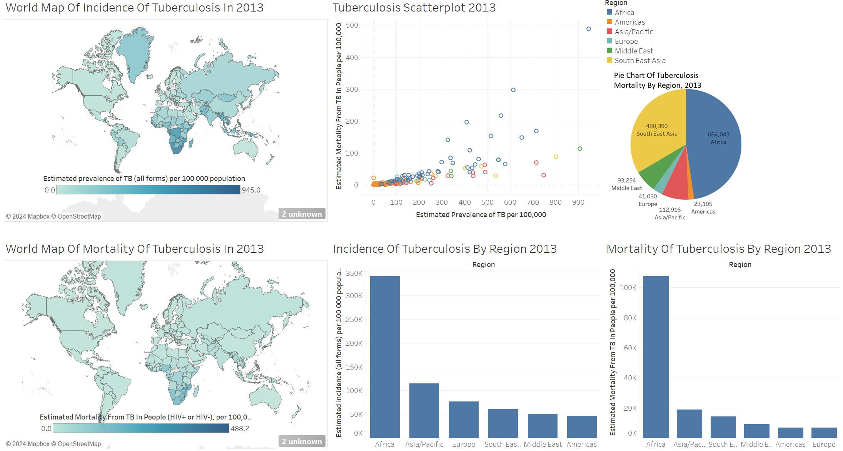
Swaziland
Lesotho

Slide 2
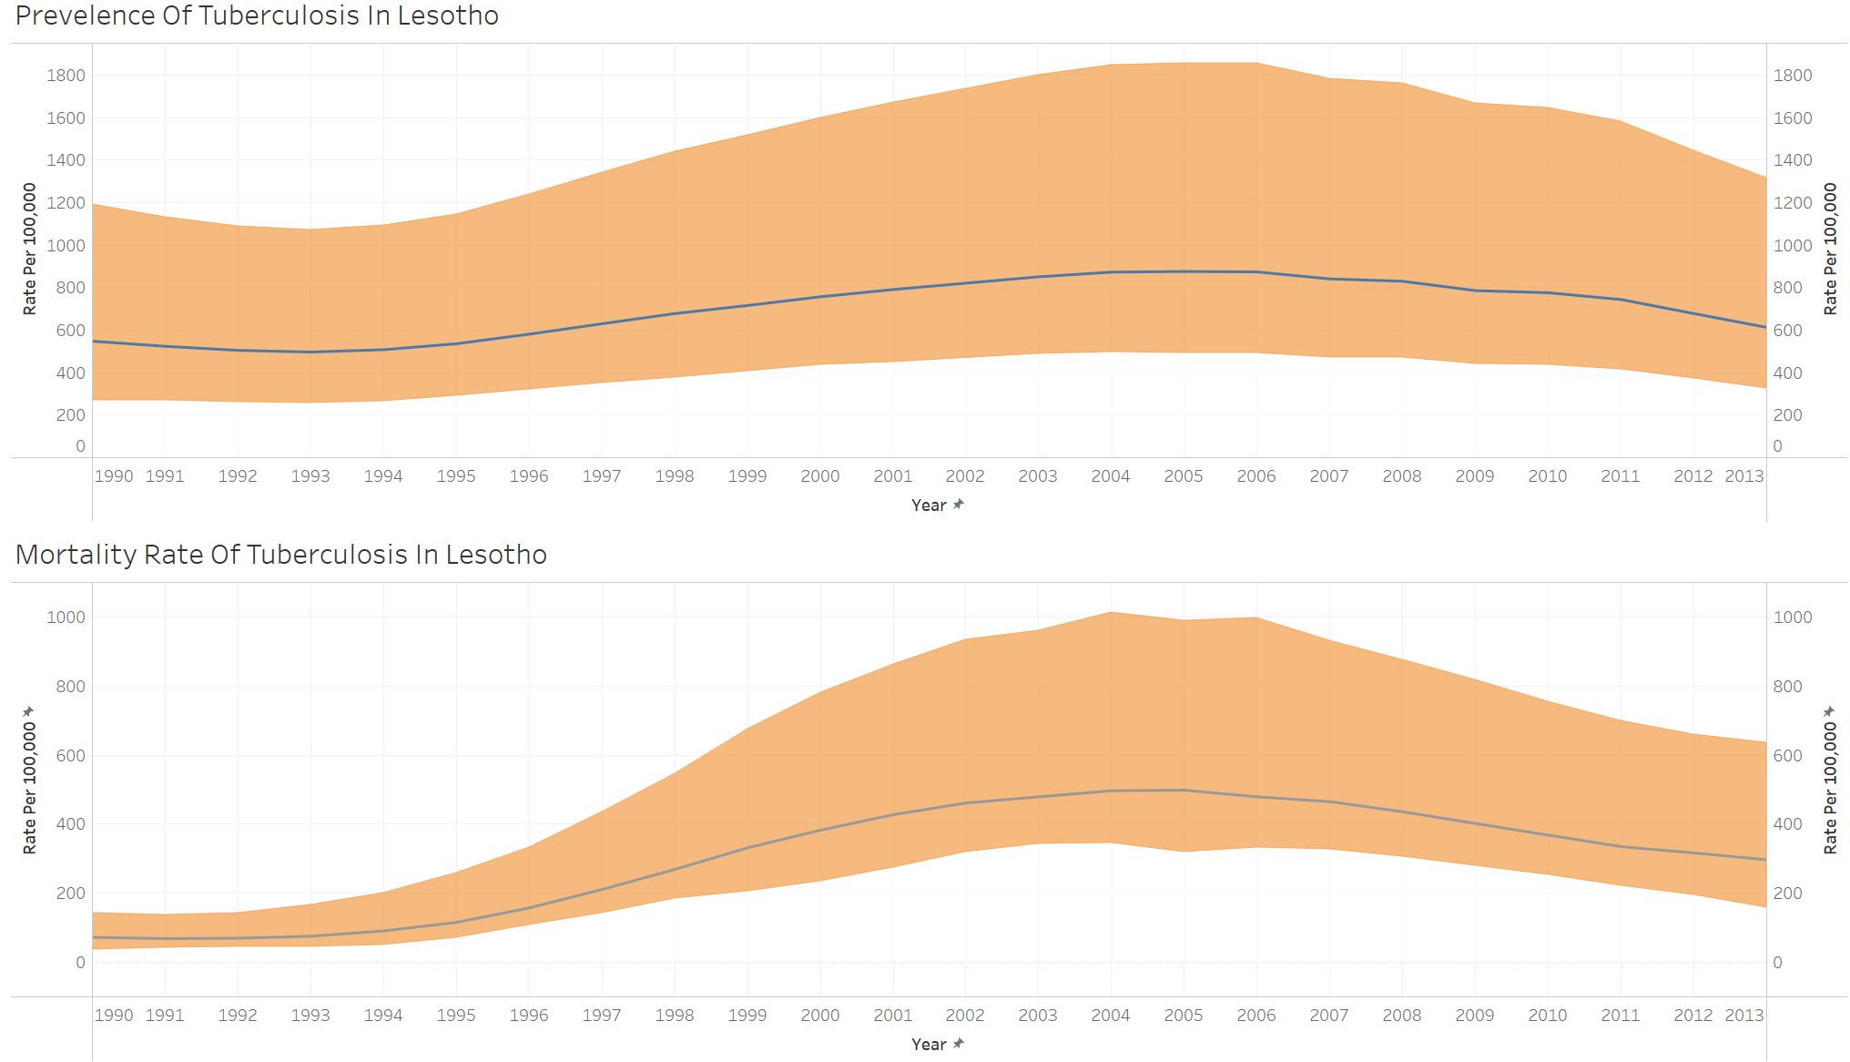
Charts show estimated rates plus 95% confidence intervals

Slide 3
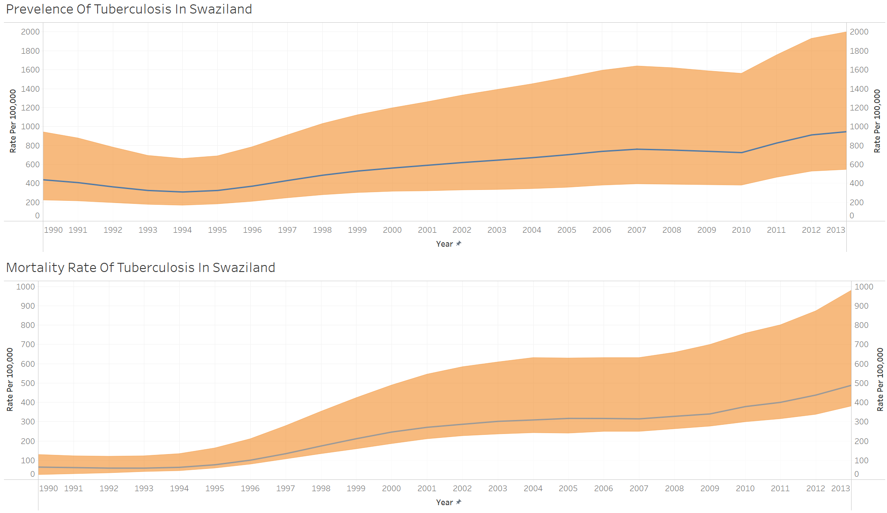
Charts show estimated rates plus 95% confidence intervals

Slide 4
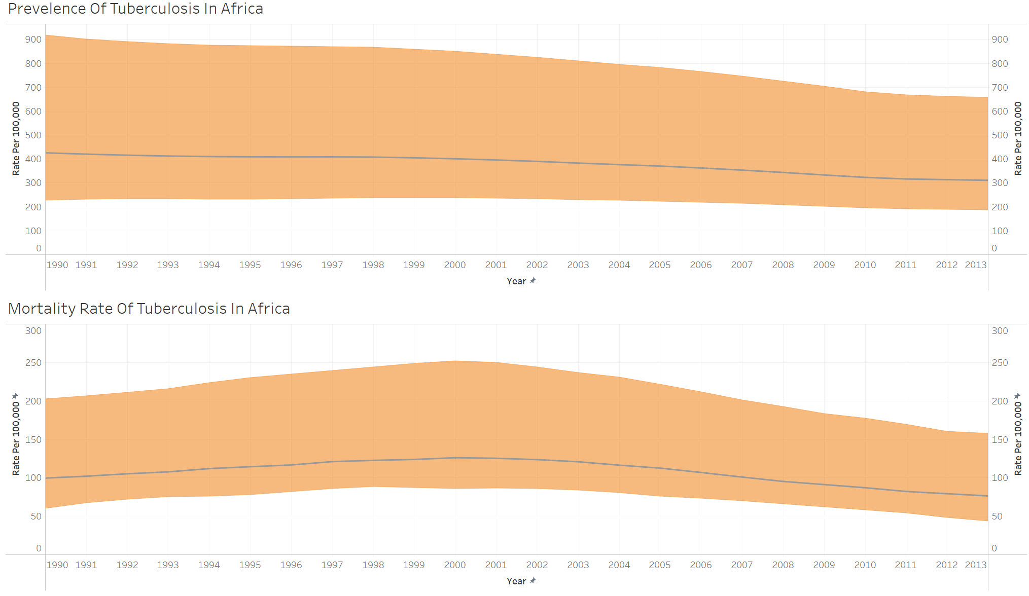
Charts show estimated rates plus 95% confidence intervals

Slide 5

Charts show estimated rates plus 95% confidence intervals

Slide 6
